Slide 1
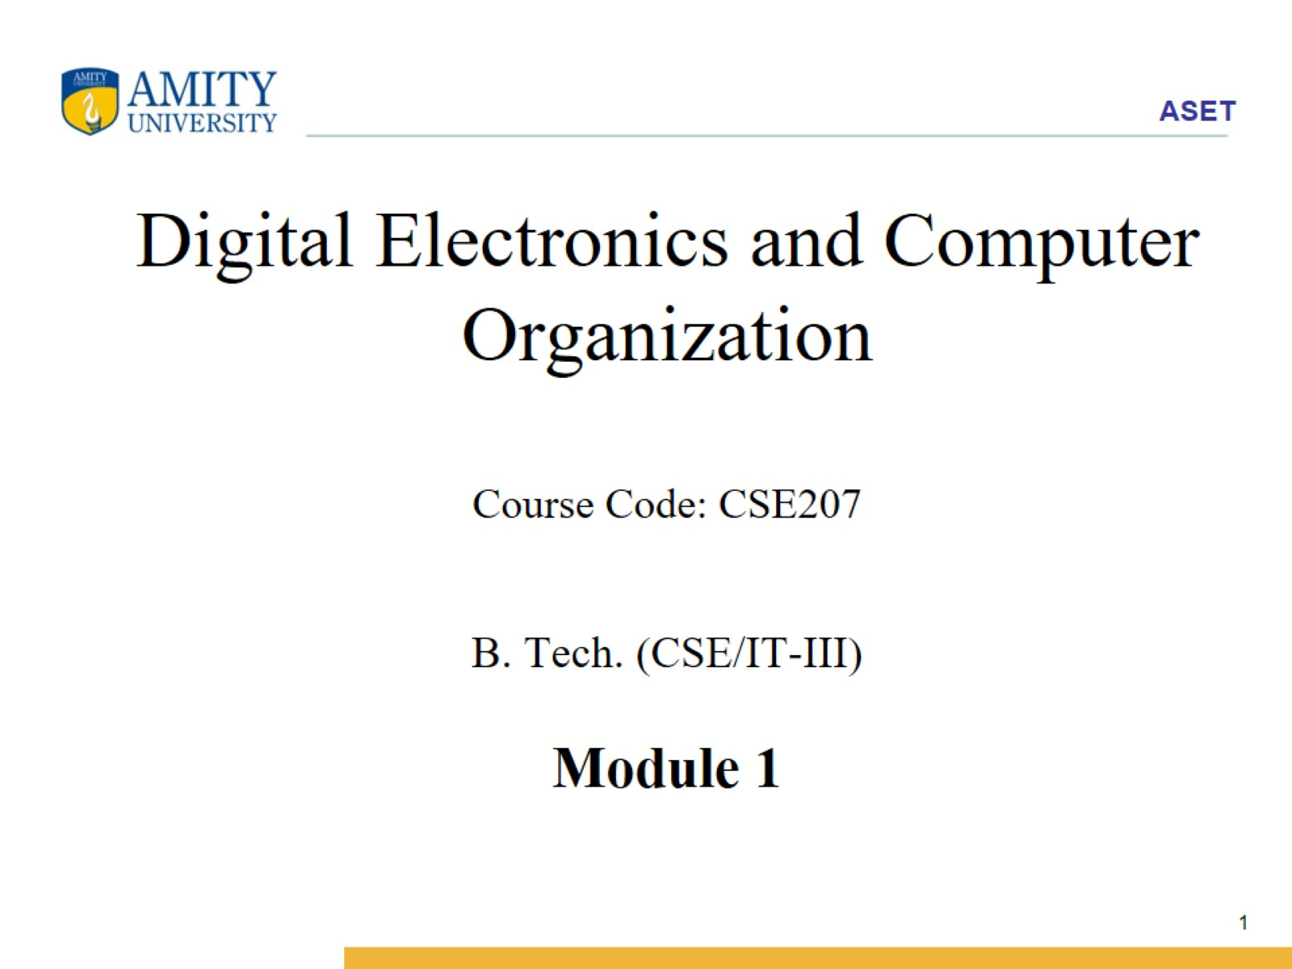
Digital Electronics and Computer Organization Course Code: CSE207 B. Tech. (CSE/IT-III) Module 1

Slide 2
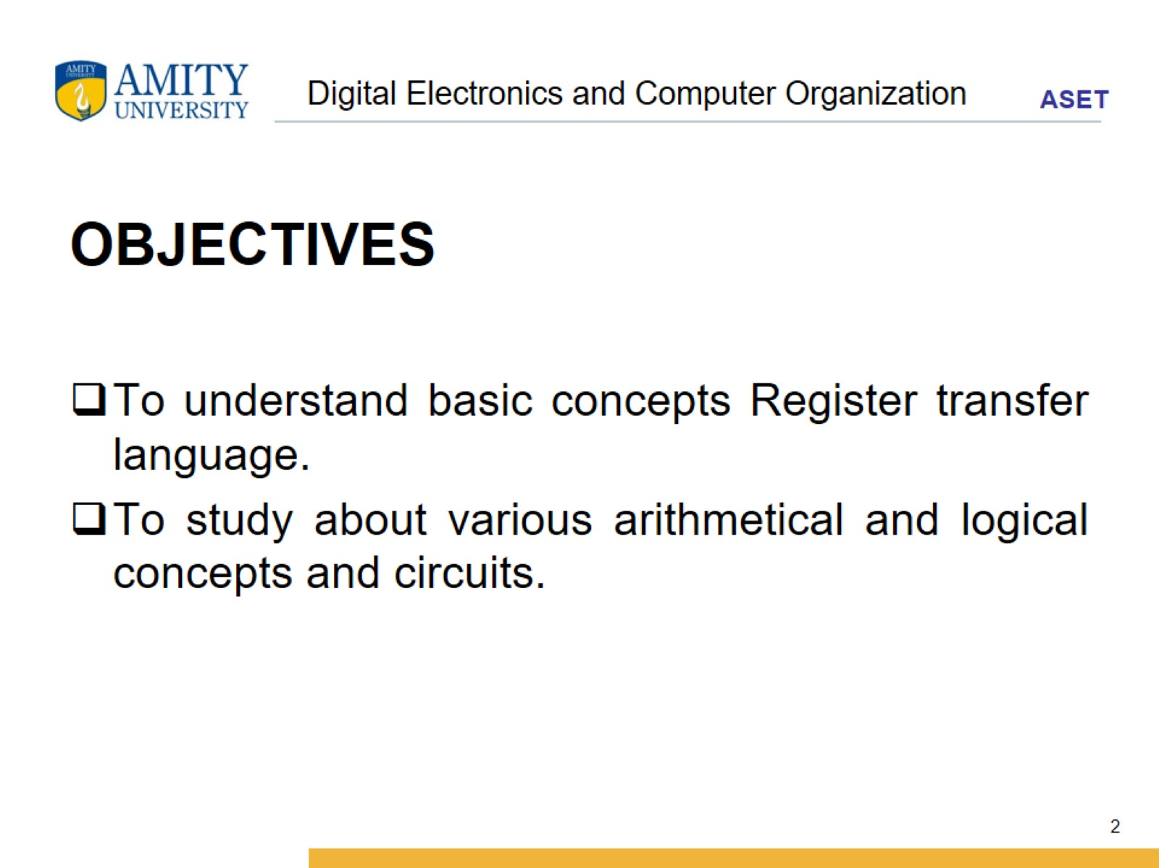
Digital Electronics and Computer Organization

Slide 3
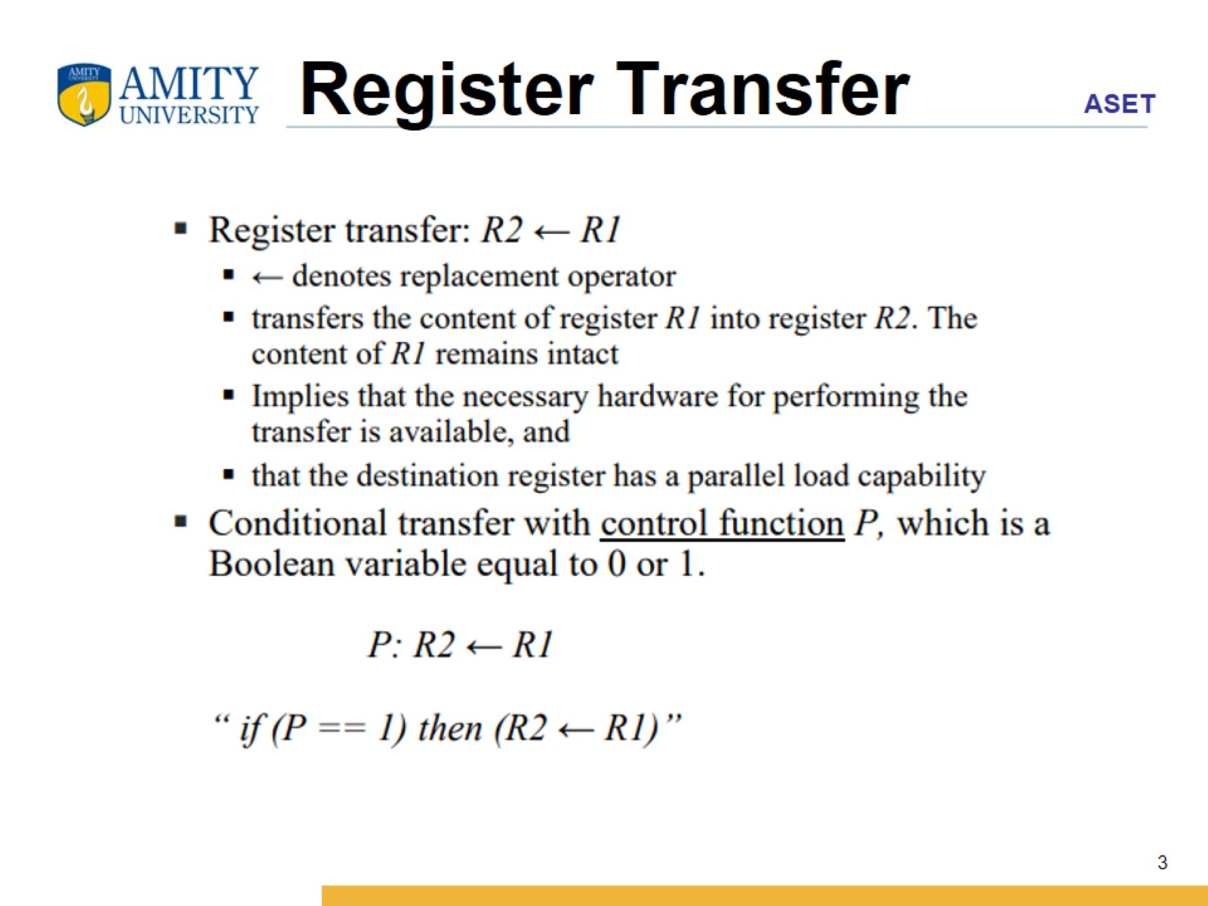
Register Transfer

Slide 4
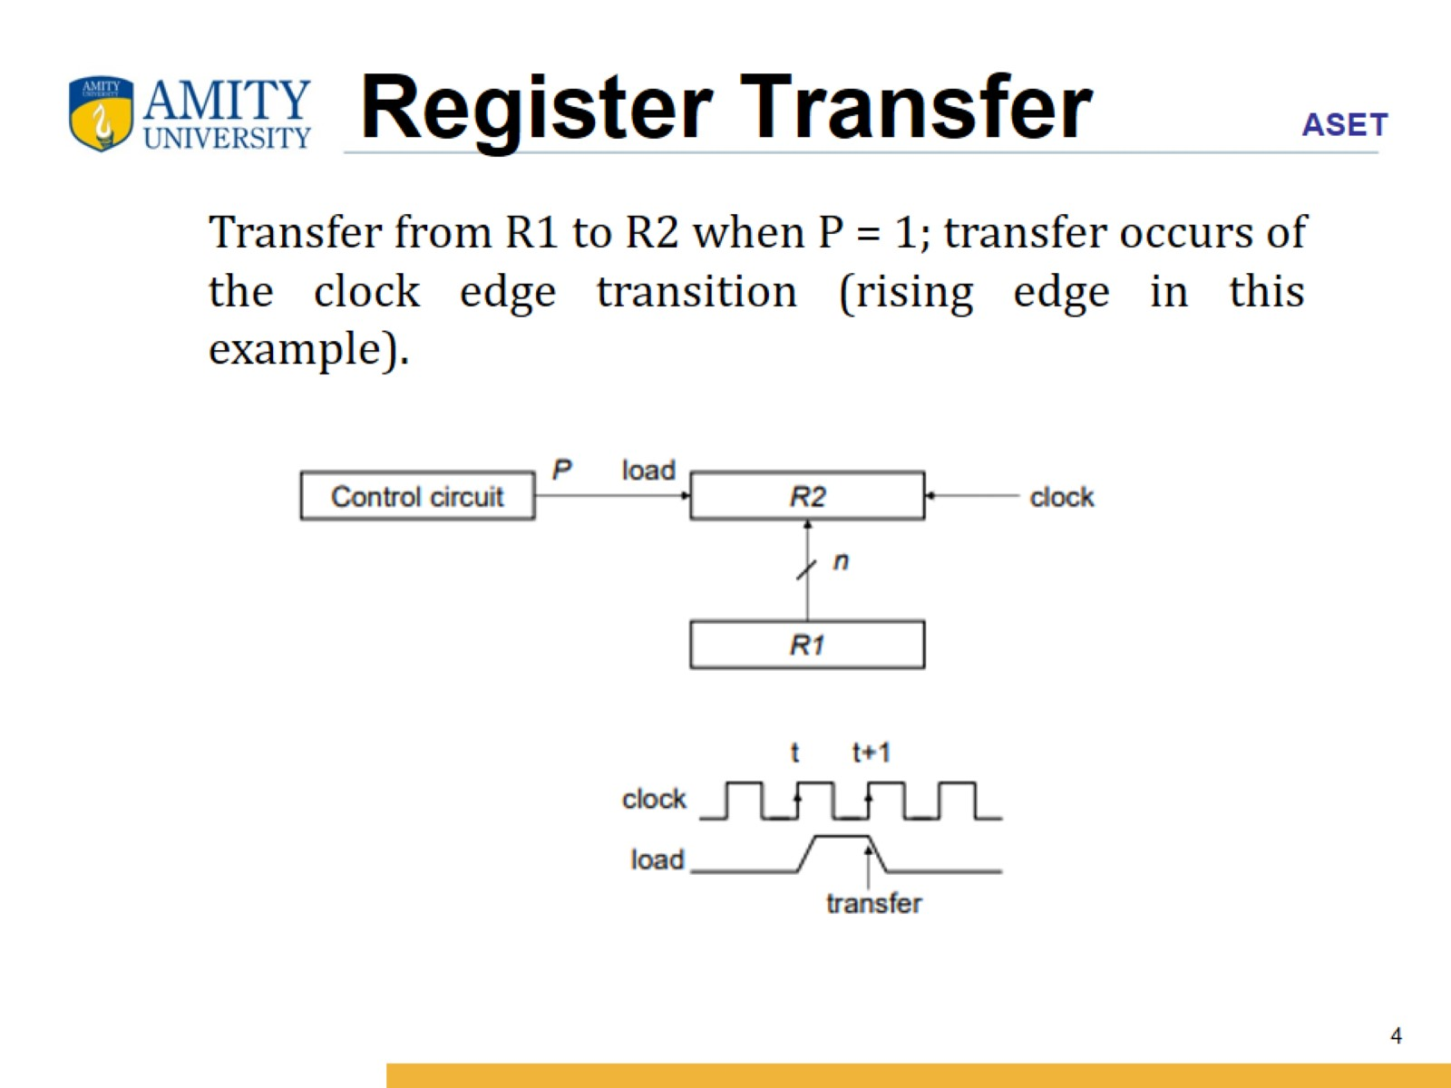
Register Transfer

Slide 5
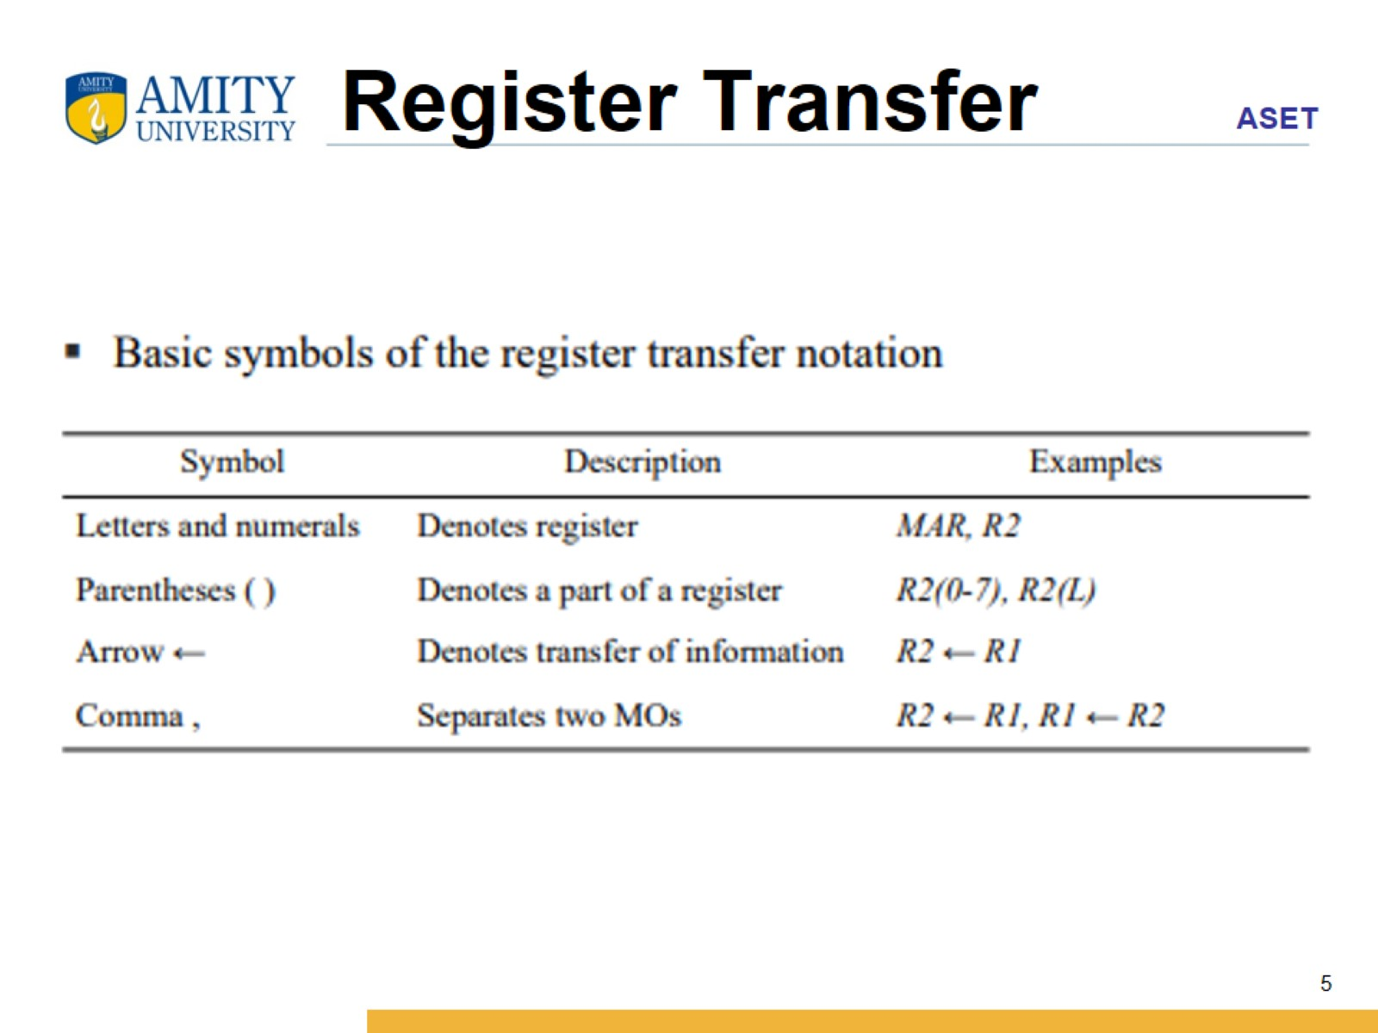
Register Transfer

Slide 6
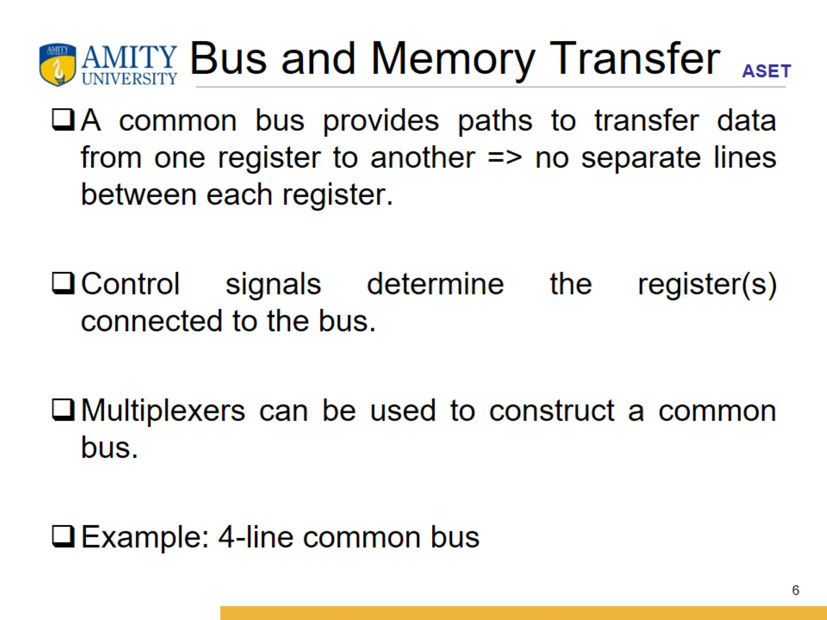
Bus and Memory Transfer

Slide 7
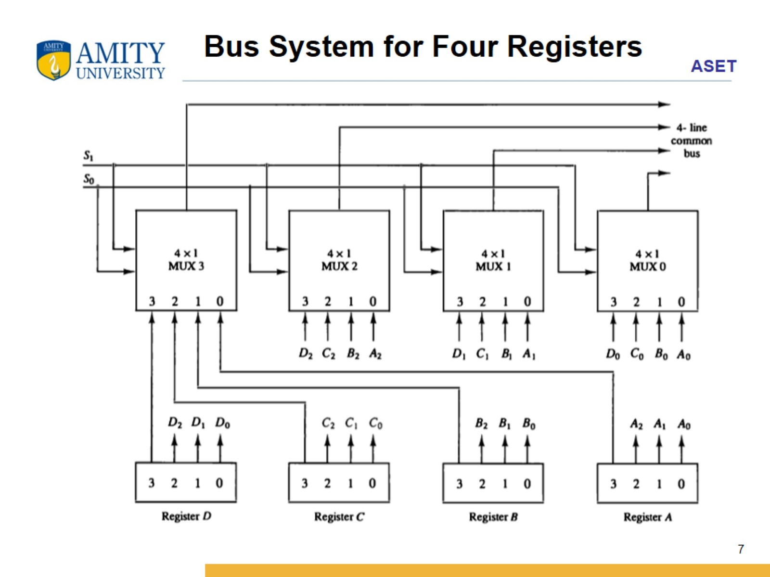

Slide 8
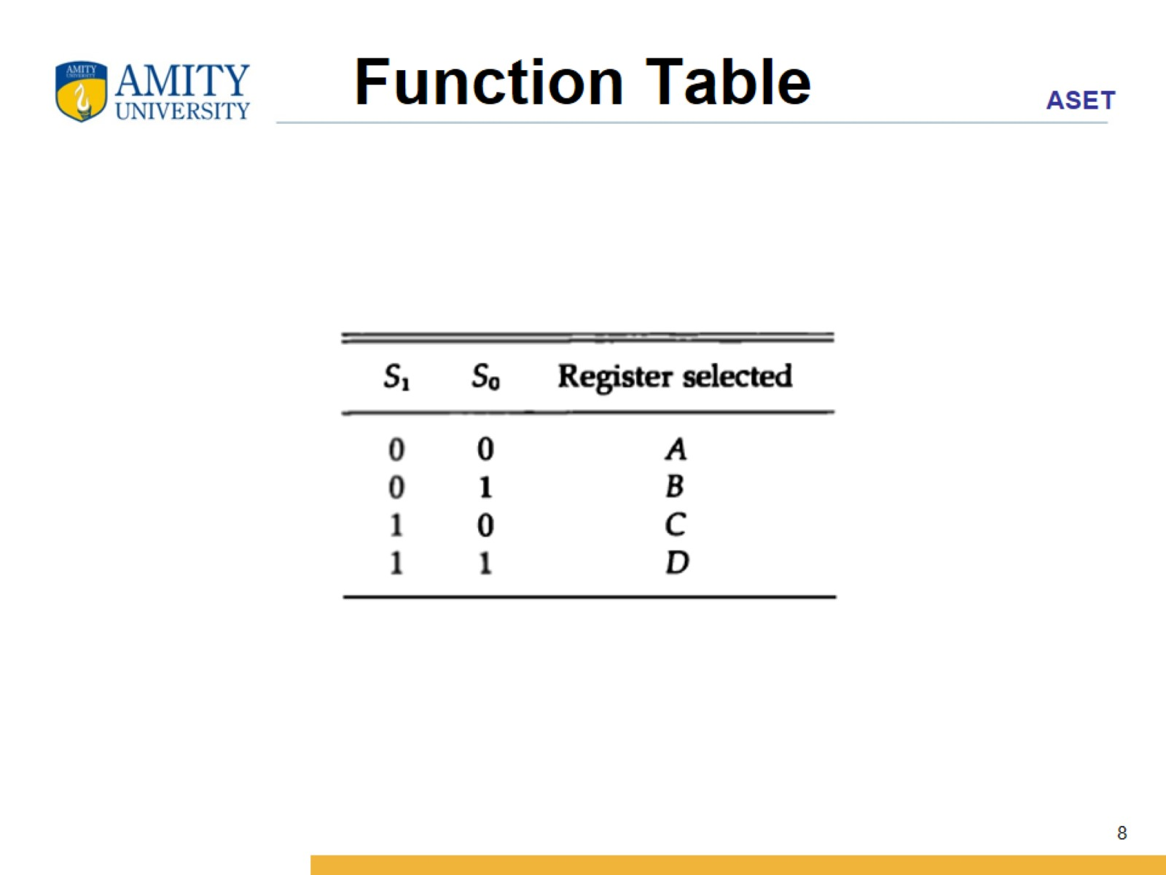
Function Table

Slide 9
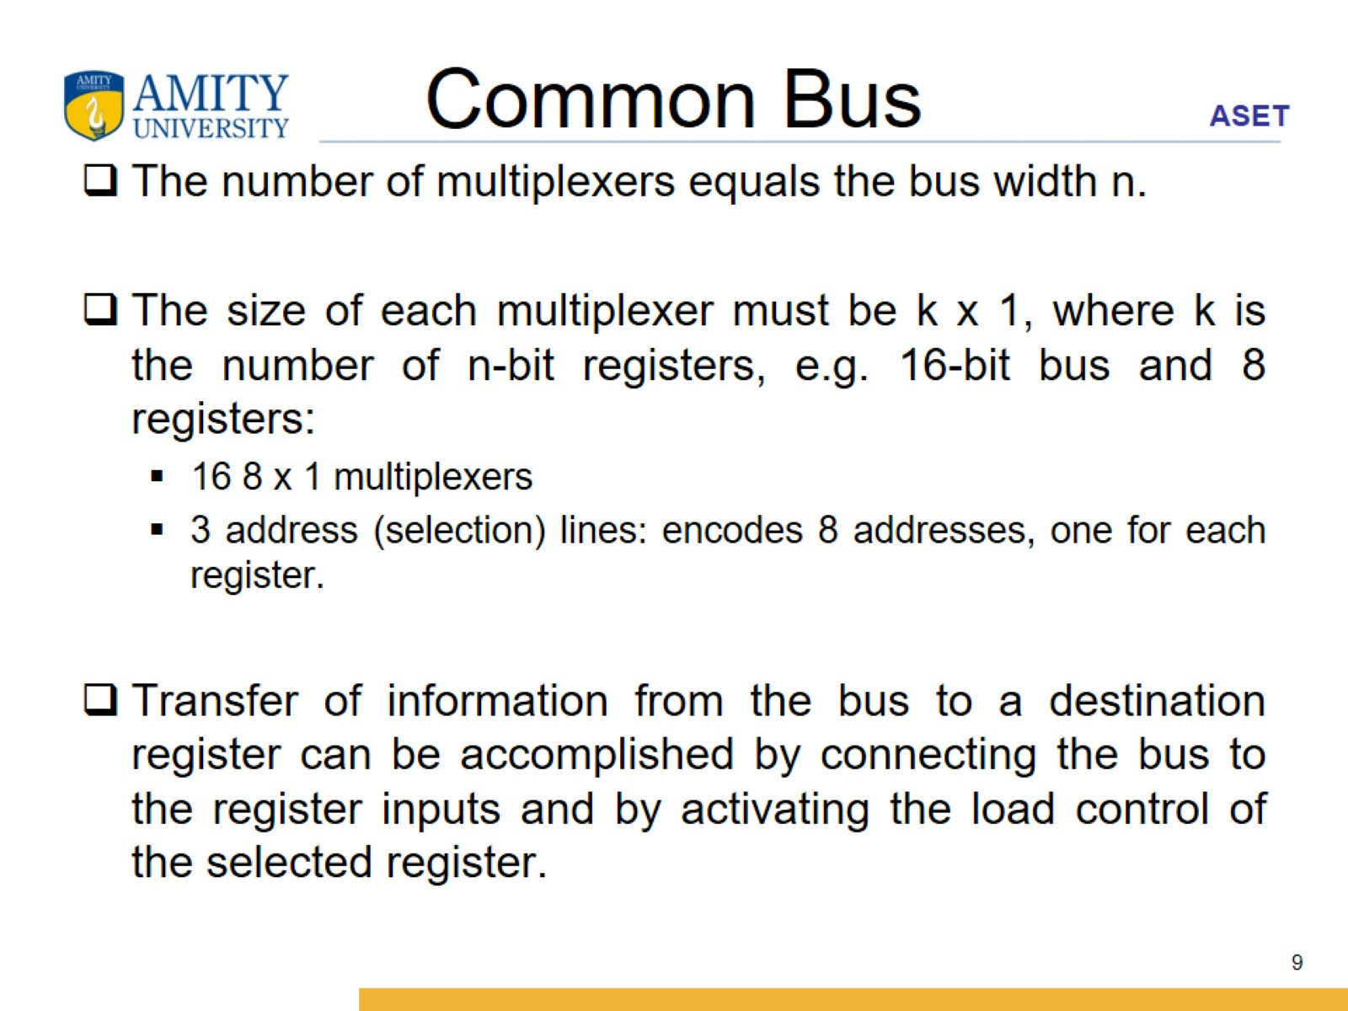
Common Bus

Slide 10
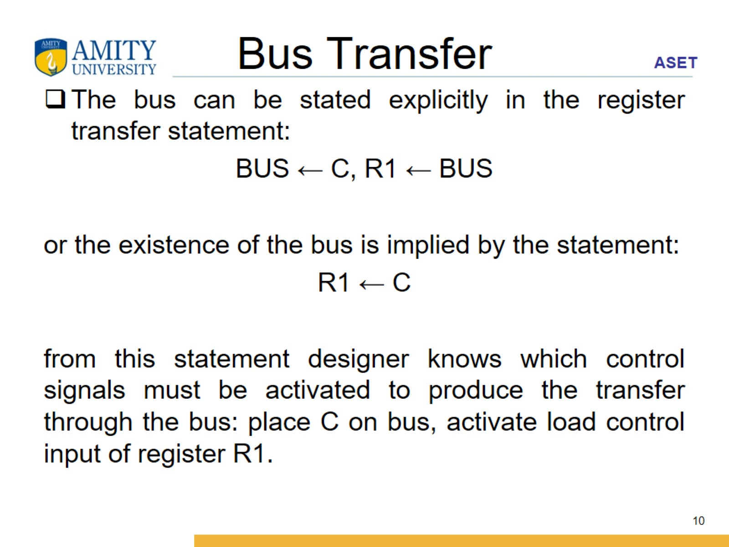
Bus Transfer

Slide 11
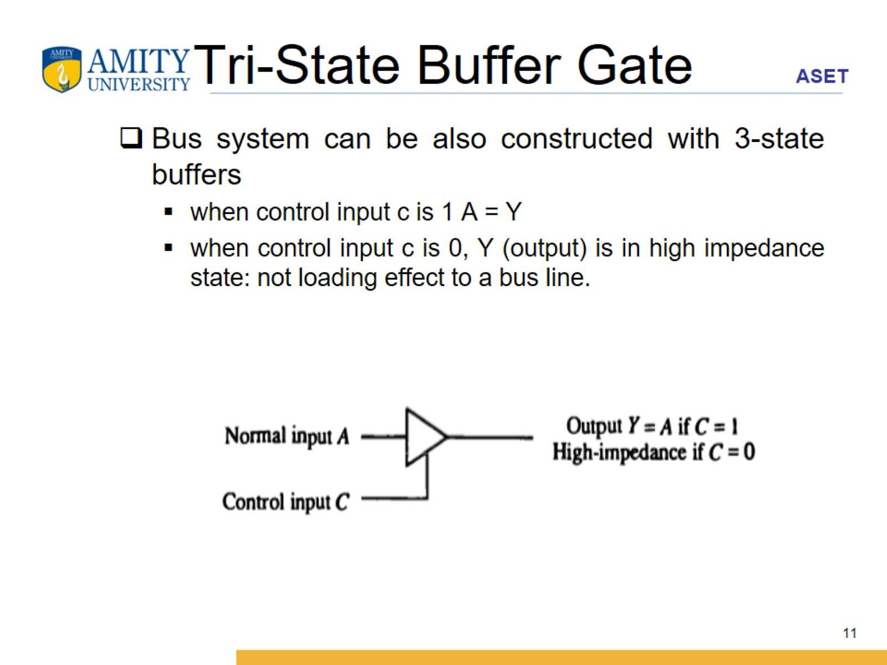
Tri-State Buffer Gate

Slide 12
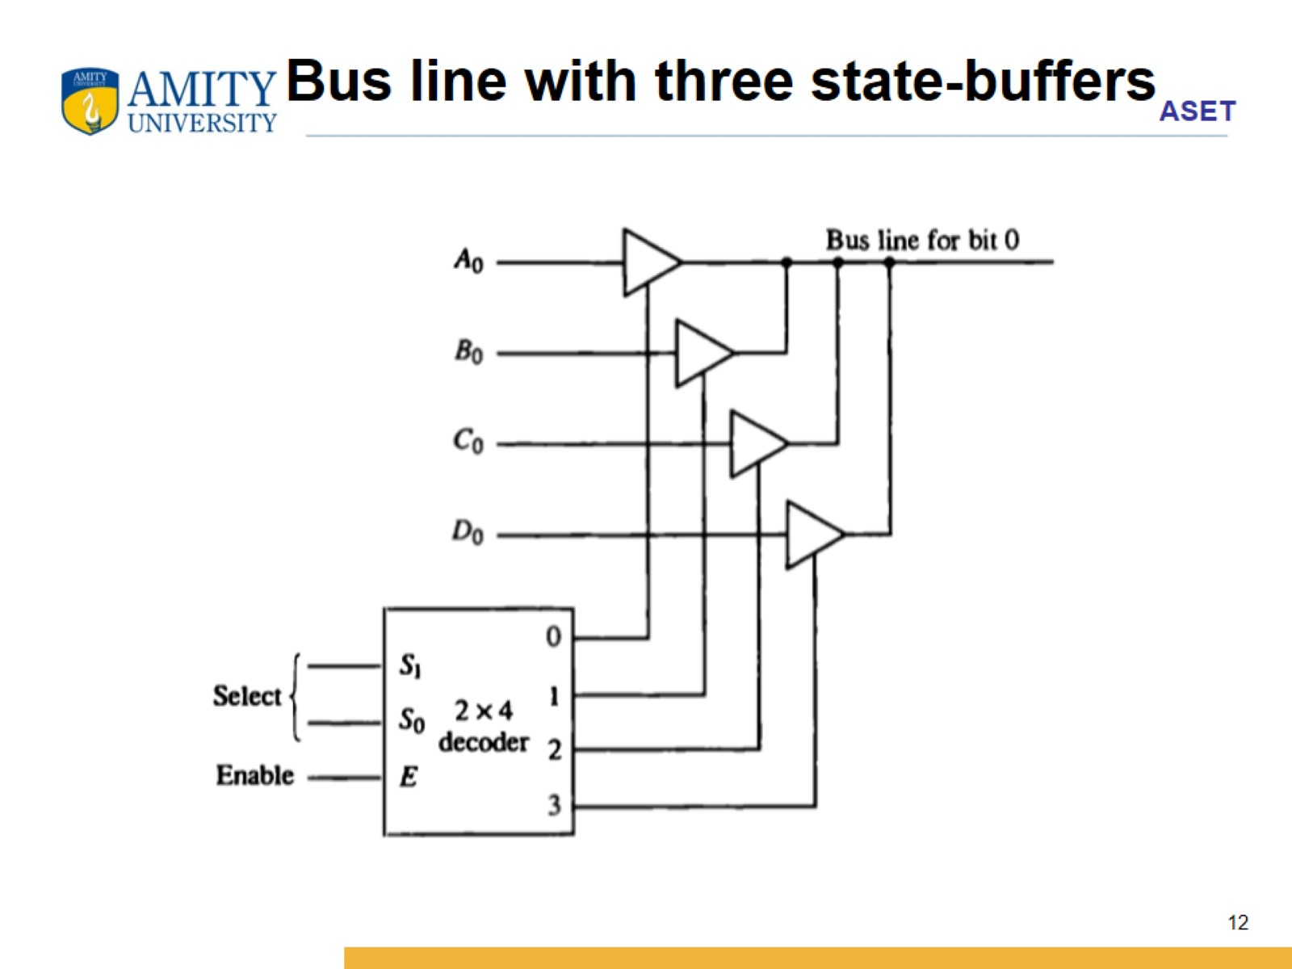
Bus line with three state-buffers

Slide 13
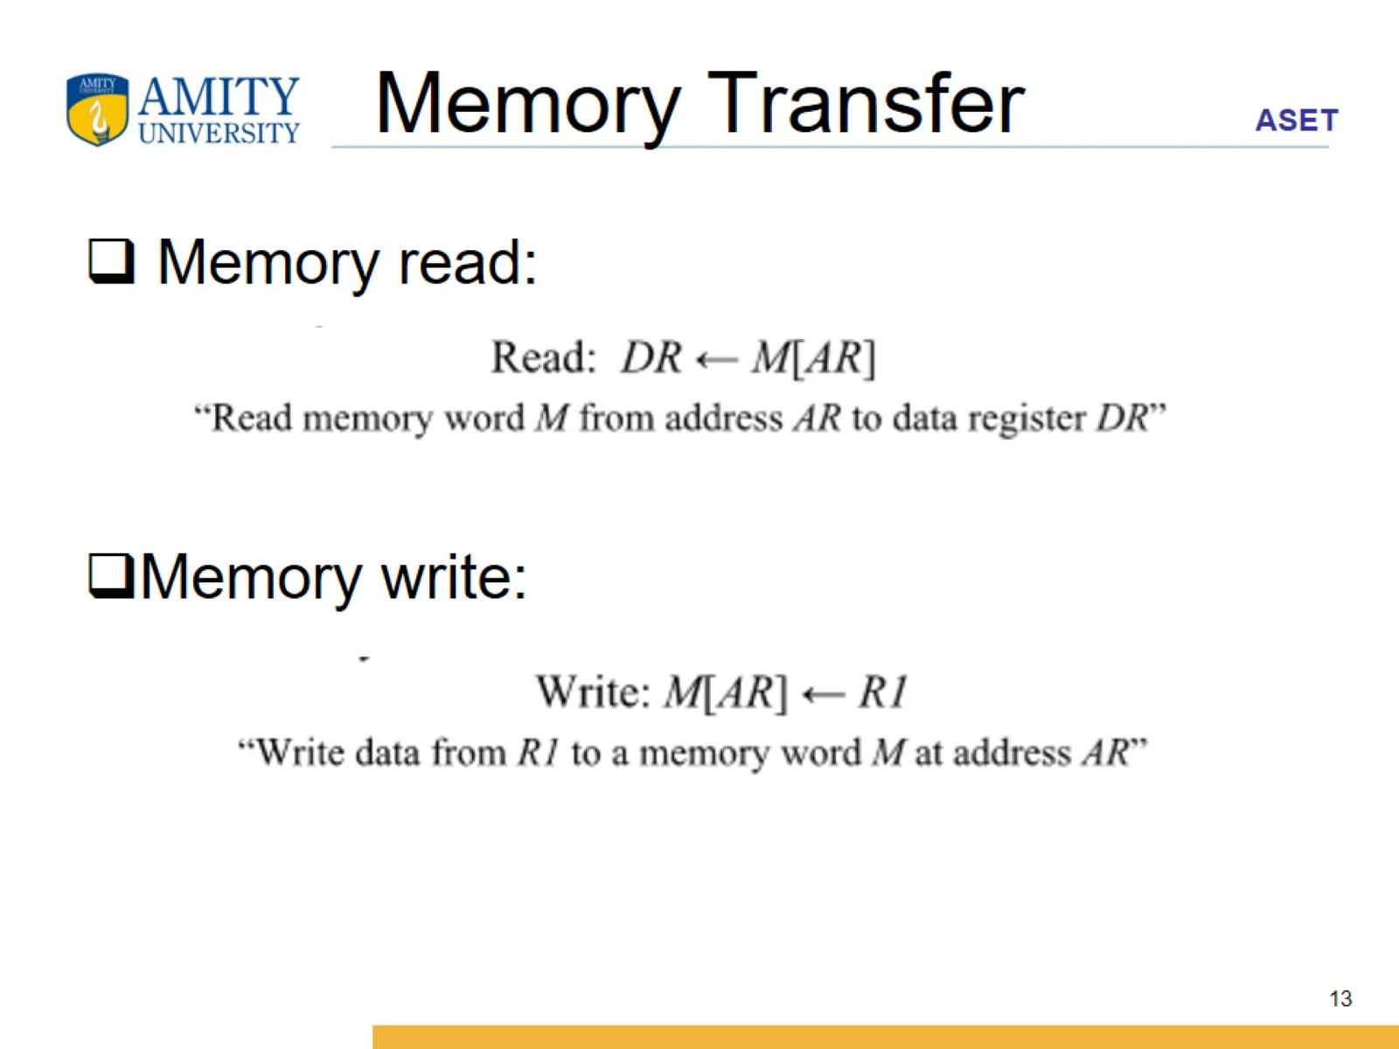
Memory Transfer

Slide 14
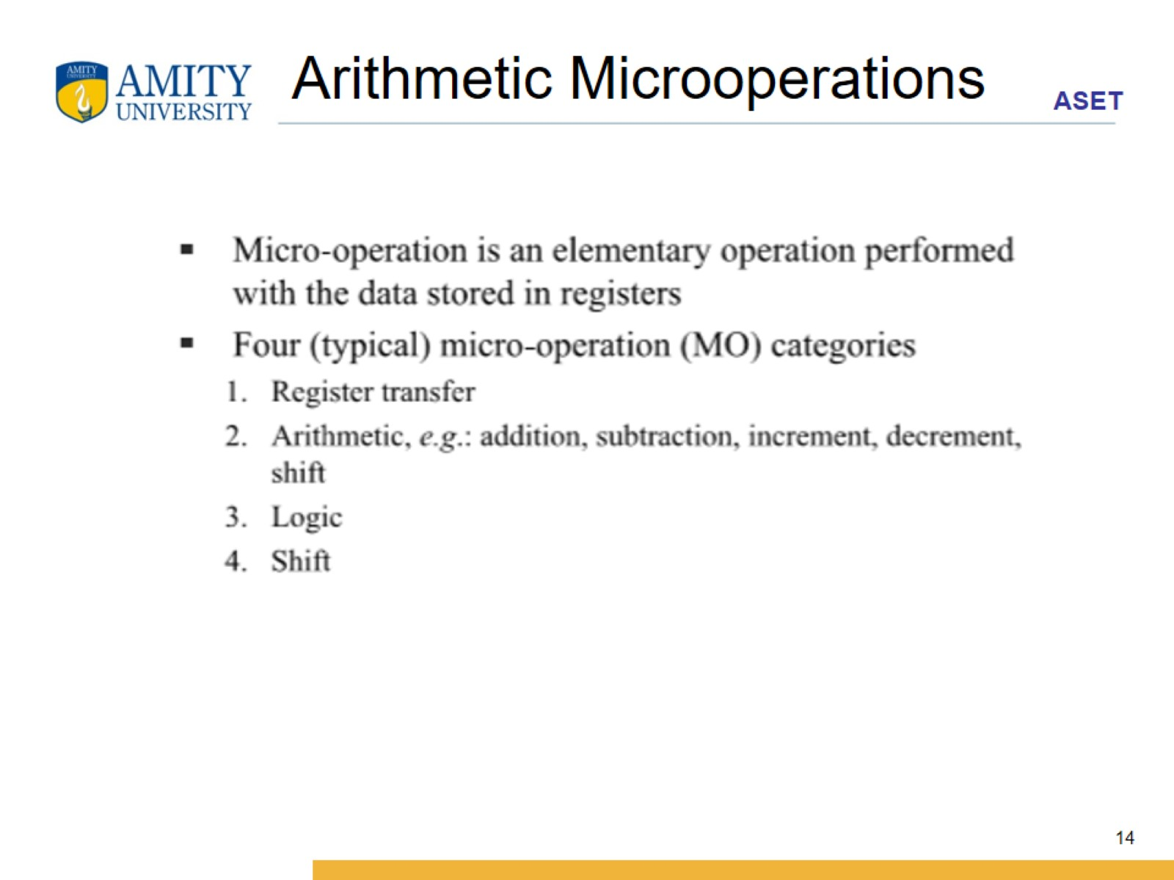
Arithmetic Microoperations

Slide 15
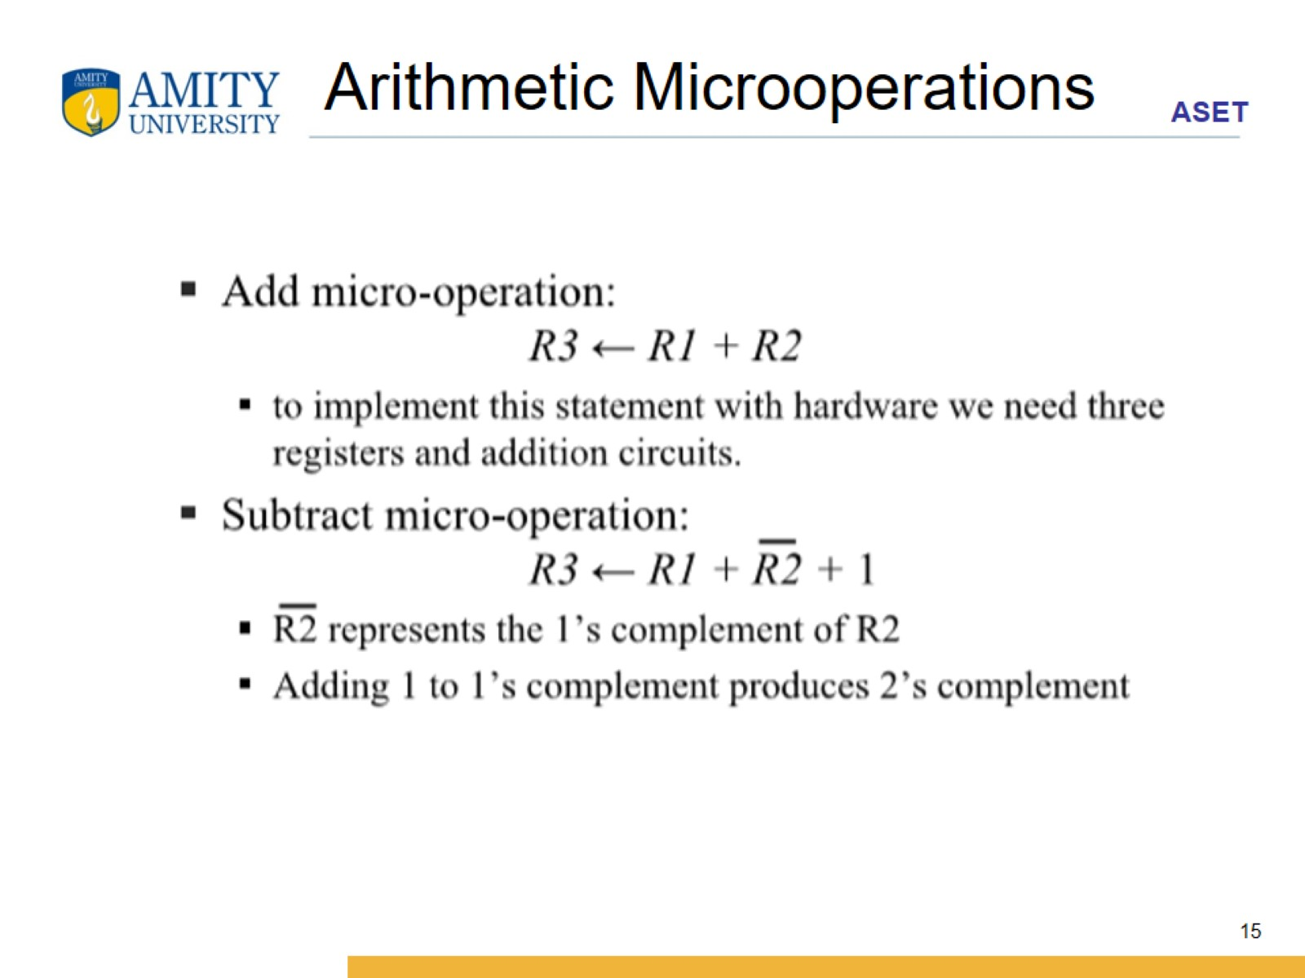
Arithmetic Microoperations

Slide 16
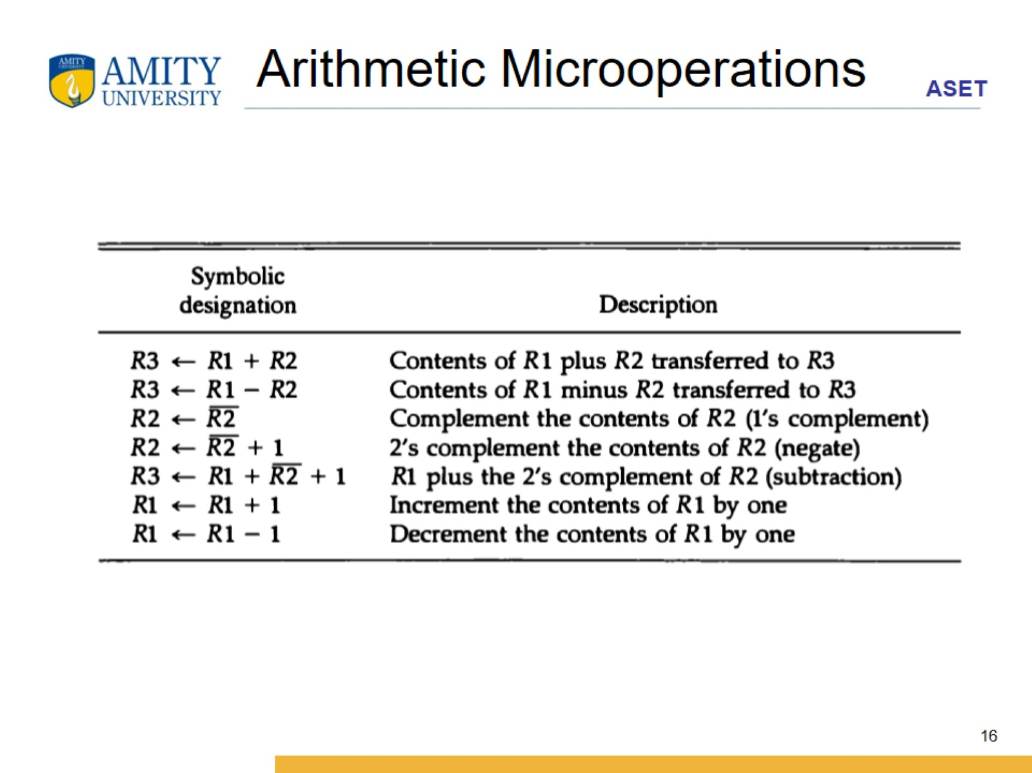
Arithmetic Microoperations

Slide 17
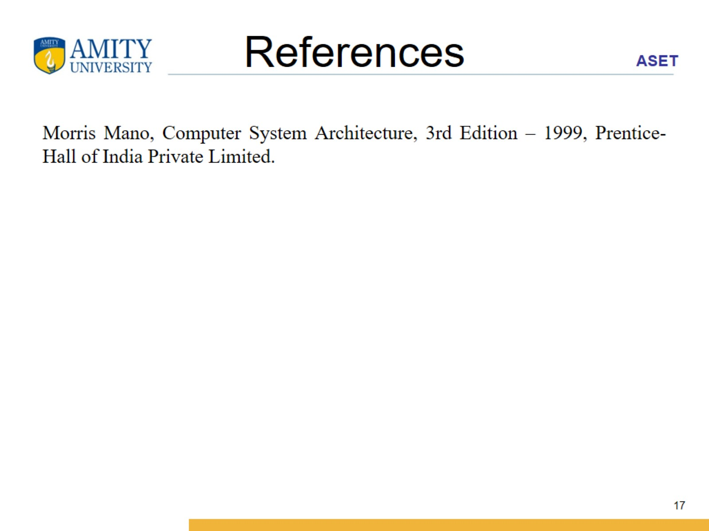
References

